Slide 1

Padam Singh

Slide 2
We will learn today
What is Laravel
Features of Laravel
Let’s install Laravel
Laravel artisan
Laravel Routing
Laravel Middleware
Laravel Blade

Slide 3
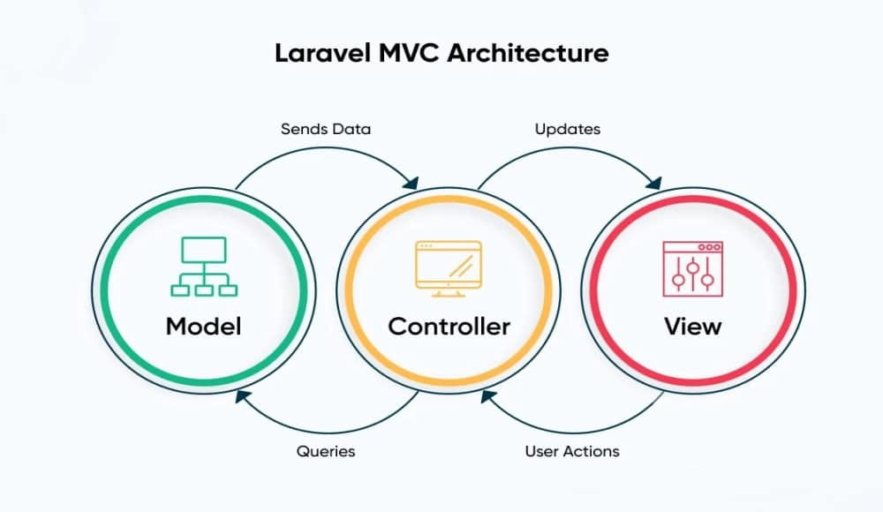


Slide 4
What is Laravel
Laravel is MVC PHP framework created by Taylor Otwell in 2011
Free open-source license with many contributors worldwide
Has powerful features, saving us time

Slide 5
Features of Laravel
Query Builder: Securely constructs SQL queries.
Restful Controllers: Manages HTTP requests (GET, POST, DELETE, etc.).
Blade Template Engine: Merges templates with data models for views.

Slide 6
Let’s install Laravel
Laravel utilizes Composer for managing its dependencies.
Composer is like a library full of books, but for PHP packages.
Not to be confused with package managers like Yum or apt.
Composer operates on a per-project basis, maintaining dependencies within the project's "vendor" folder.

Slide 7
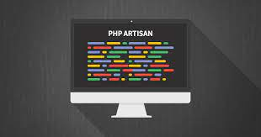
Laravel Artisan
Artisan is command-line interface for Laravel
Commands that are saving time
Generating files with artisan is recommended
Run php artisan list in the console

Slide 8
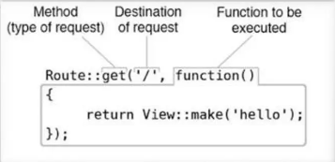
Laravel Routing
The best and easy routing system I've seen
Routing per request method (GET, POST, DELETE, etc.)
ALWAYS name your route !
Be careful with the routing order!
Let's see routing examples

Slide 9
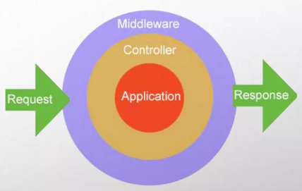
Laravel Middleware
The middleware is mechanism for filtering the HTTP requests.
Laravel includes several middleware's - Authentication, CSRF Protection.
The auth middleware checks if the user visiting the page is authenticated through session cookie.
The CSRF token protection middleware protects your application from cross-site request forgery attacks by adding token key for each generated form.

Slide 10

Laravel Blade
Blade is the powerful template engine provided by Laravel
All the code inside blade file is compiled to static html file
Supports plain PHP
Saves time
Better components mobility, extend and include partials
Let's take a look at few examples

Slide 11
Laravel Practical Task

Slide 12


